Slide 1
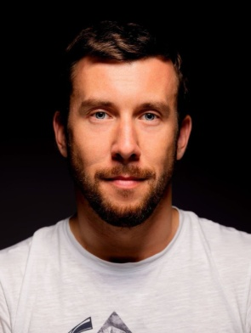
Специализированные технологии машинного обучения/ Advanced Machine learning Technologies
Peter Gladilin
PhD
Associate Professor in ITMO University
Senior R&D Engineer in Huawei
8 lectures
12 labs (practice)
6.09 – 15.09 - Tuesday/Thursday 18-40 (lecture) + 20-20 (practice)
No studies from 16.09 to 30.09!
4.10 – (~18.10) - Tuesday/Thursday 18-40 (lecture) + 20-20 (practice)
Exam (2nd part of October) - for all groups + Course Project (separate mark)
4 passed lab tasks as your permission to the exam
“4C” automatically if you have all 4 labs in time

Slide 2
Plan of the course:
Time Series analysis and prediction – task #1
Reinforcement Learning (RL)
Interpretable Machine Learning – task #2
GANs and VAEs – task #3
Modern Image & Video Signal processing
Quality Assessment in Deep Learning – task #4
Attention and Transformers
Mobile and Tiny AI. DL Deployment.

